Slide 1
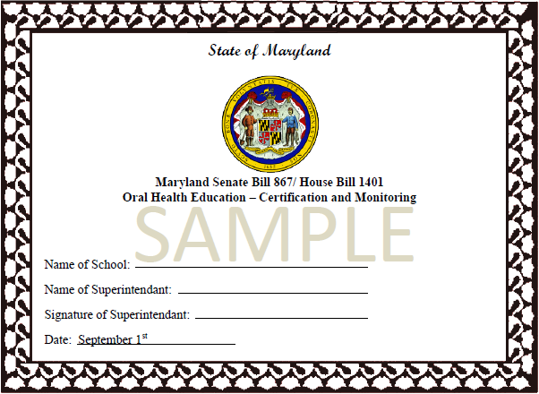
Maryland Senate Bill 867/House Bill 1401
Oral Health Education –
Certification and Monitoring
March 1, 2012

Slide 2
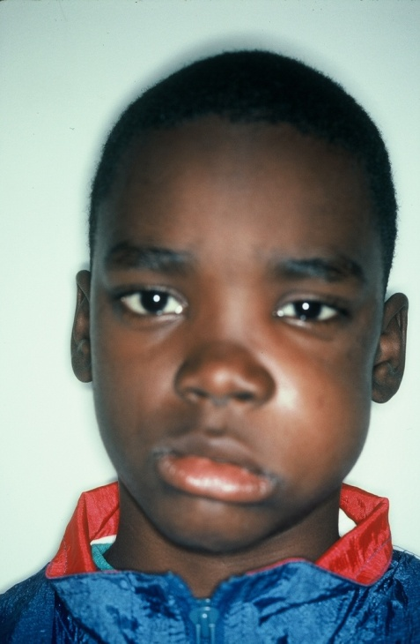
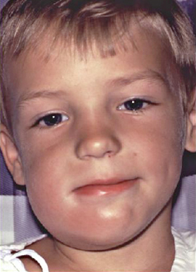
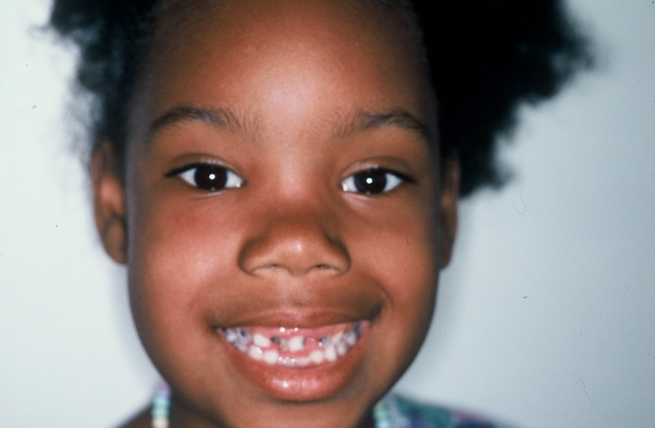
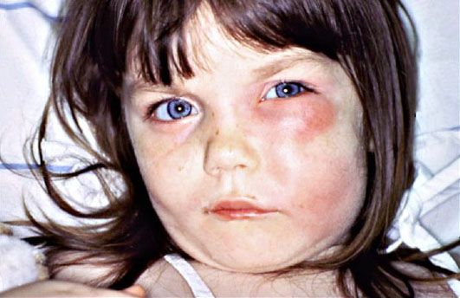
Facial Cellulitis
Due to untreated dental abscess

Slide 3
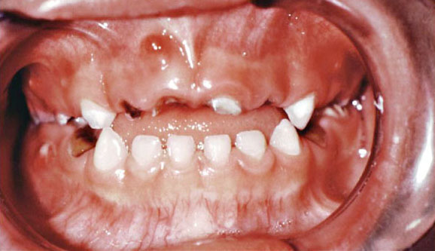

Slide 4

Signs and Symptoms of Oral Health Neglect
Symptoms
elevated temperature
foul smelling breath
drooling
detached
clenched teeth
chapped lips
teeth with brown stains
teeth with black holes
mouth sores
swollen lip
swollen eye
swollen cheek
swollen neck
dehydrated
frequent earaches
frequent headaches
impaired speech
hyperactive
Signs
frequently absent
does not sing
seldom laughs
frowned face
hand over the mouth
unbalanced gait
head on the desk
rocks back & forth
tearful wailing
refuses to eat
moans & groans
withdrawn
paces the floor
angry outbursts
often irritable
hands over eyes
low test scores
inability to concentrate
low self esteem

Slide 5
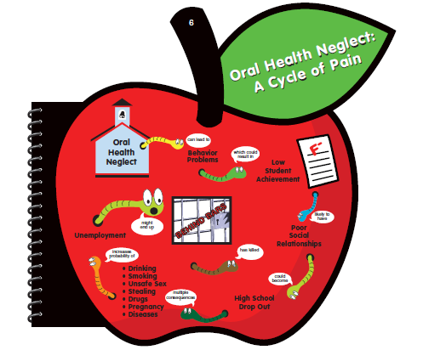

Slide 6
Dental Deaths

Slide 7


Slide 8
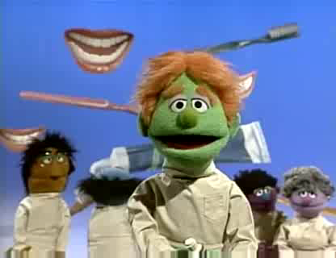

Slide 9

Thank you Maryland!

