Slide 1


Slide 2

Presents!

Slide 3
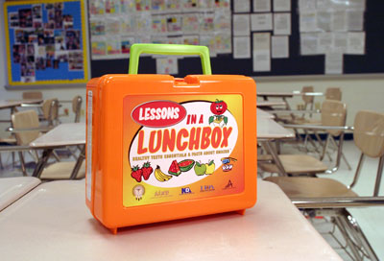
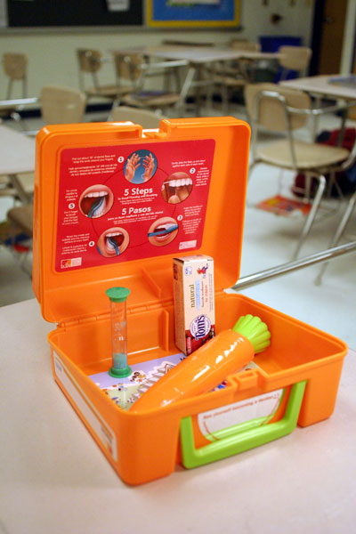
      Lessons In Lunch Box:
Healthy Teeth Essentials & Facts About Snacks™

Slide 4

Objectives
Understanding,
I. The origin of the Lessons In A Lunch Box
program
II. How the DTA Foundation funding made a
difference in the Lessons In A Lunch Box
program
III. The current status of the Lessons In A
Lunch Box program
IV. The future of the Lessons In A Lunch Box
program

Slide 5

I. Lessons In A Lunch Box

Slide 6

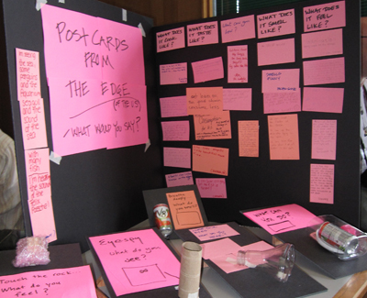
2004
The idea for the lunch box was
conceived while shopping for a
birthday gift for a child.
2005-2006
Prototype Development

Slide 7
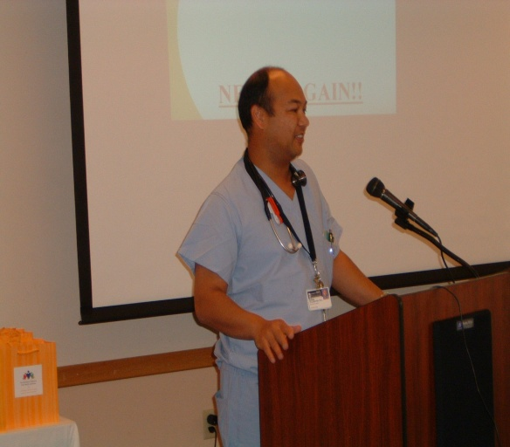

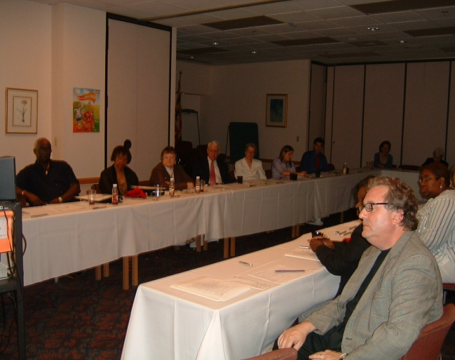
2007 Tour of Duty
A breakfast presentation was held in a Baltimore hospital conference center to introduce the Lessons In A Lunch Box Program locally. We shared prototype samples of the lunch box and gave a power point presentation to help demonstrate the important need for oral health education in the classroom. Speakers included the chief anesthesiologist, dental professionals and educators. Invited guest included school principles, teachers, city officials, legislative leaders and parents.

Slide 8
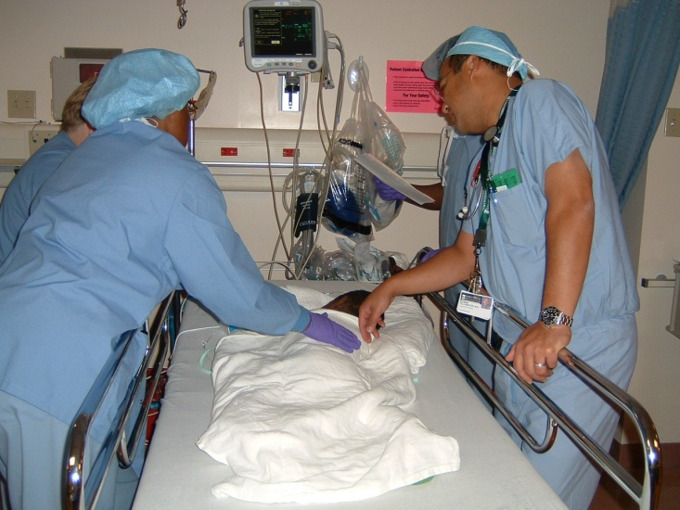
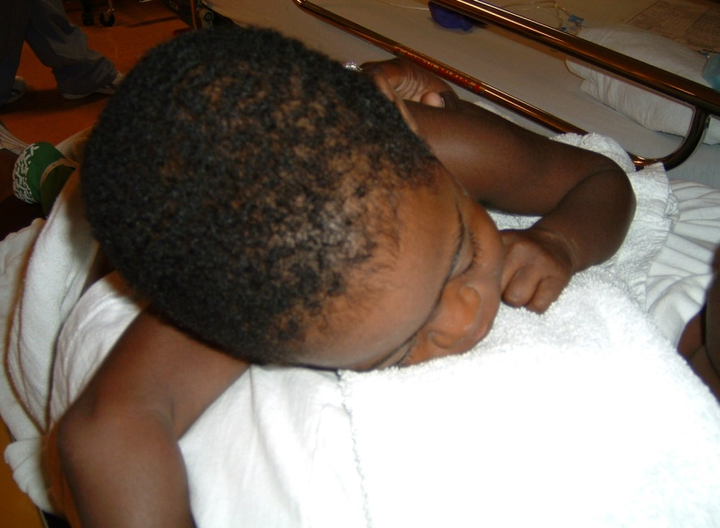
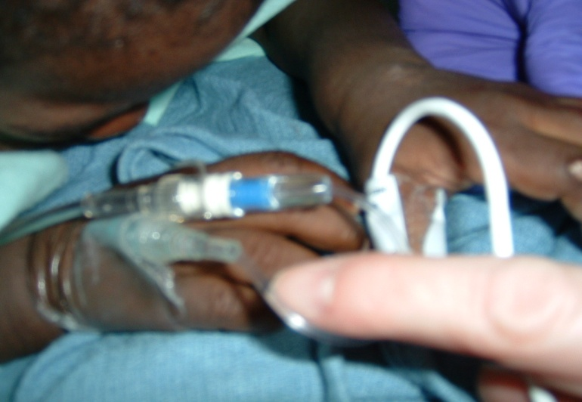
Tour of Duty guest witnessed the experience children are subjected to when they must undergo general anesthesia in the hospital for dental treatment.

Slide 9

2007
Commitment of organized dentistry solidified
Grant funding and in-kind donations sought
Corporate financing and sponsorship petitioned

Slide 10

In September of 2007 the DTAF awarded The Children’s Oral Health Institute $25,000!

Slide 11

2008
First Shipment of lunch boxes arrive in Baltimore ~ January 3rd.

Slide 12
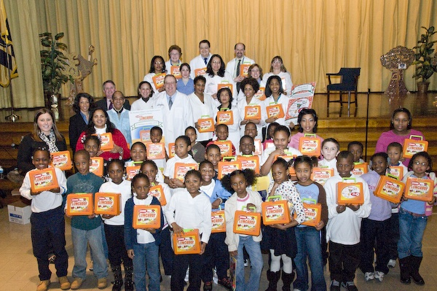
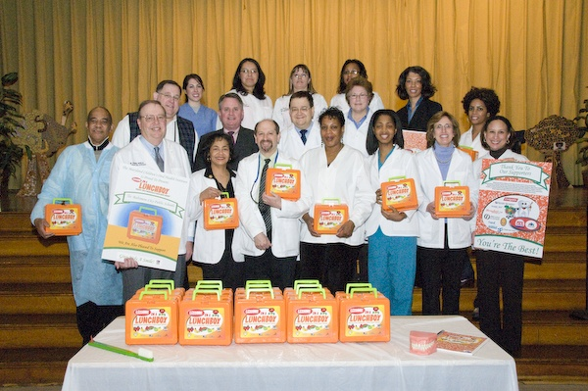
January 2008
      Lessons ln A Lunch Box launched in conjunction with
      Give Kids a Smile Day!
Group photo with students at Franklin Square Elementary School at the first
Lessons In A Lunch Box program.
University of Maryland student dentists, and members of Maryland State Dental Association and Maryland Dental Society.

Slide 13
February 2008
Press Conference
2/28/08 Lessons In a Lunch Box Educational Program Teaches Children to Practice Good Dental Hygiene
“Deans Leo Rouse, Howard University College of Dentistry and Christian Stohler, University of Maryland, Baltimore College of Dental Surgery applauded the introduction of the promising dental education program. Both attended the February 11th Press Conference & Media Reception at the National Museum of Dentistry and communicated being pleased to see “Lessons In A Lunch Box” début after much due diligence.”

Slide 14
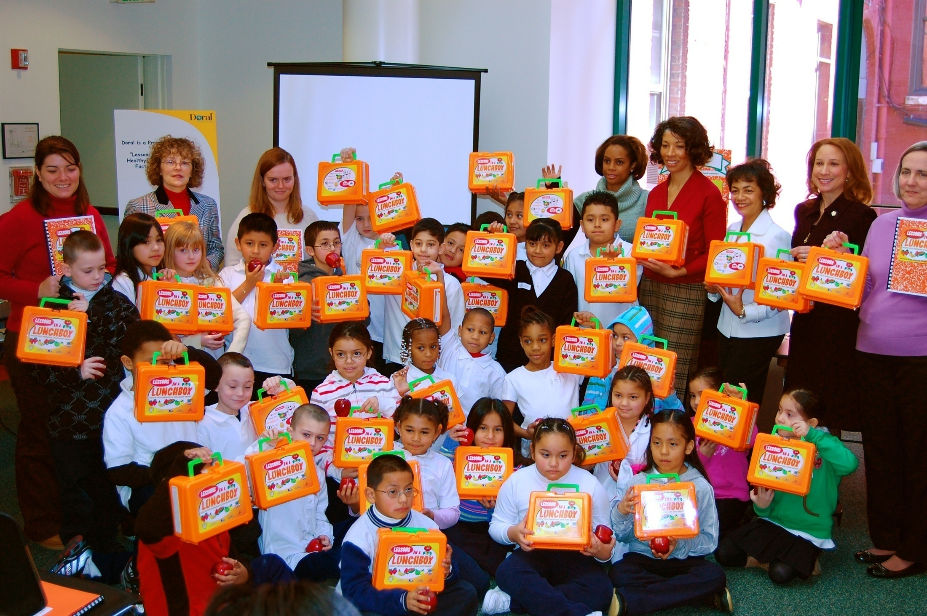
Group photo with students from John Ruhrah Elementary School at Press Conference & Media Reception

Slide 15
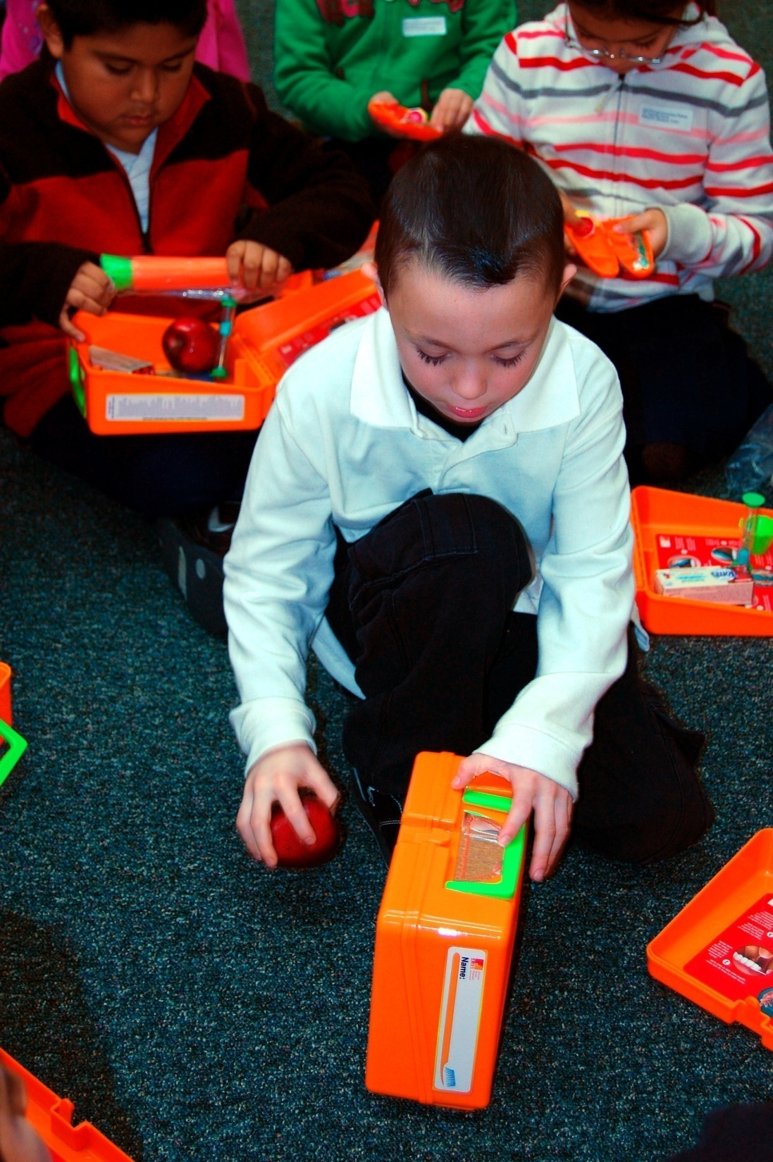
Seeing himself becoming a dentist.

Slide 16
Lessons In A Lunch Box presented to the Council of Dental School Deans
3/31/08 Dental School Leaders Show Enthusiastic Response for MCOHI's
Innovative Approach
March 2008
The “Lessons In A Lunch Box: Healthy Teeth Essentials” program received applause from the American Dental Education Association’s Council of Dental School Deans on Saturday, March 29th in Dallas, Texas. By the end of the presentation over half (~33) of the deans had completed the preliminary registration forms necessary to introduce the initiative to their dental students and a community Title One elementary school.

Slide 17
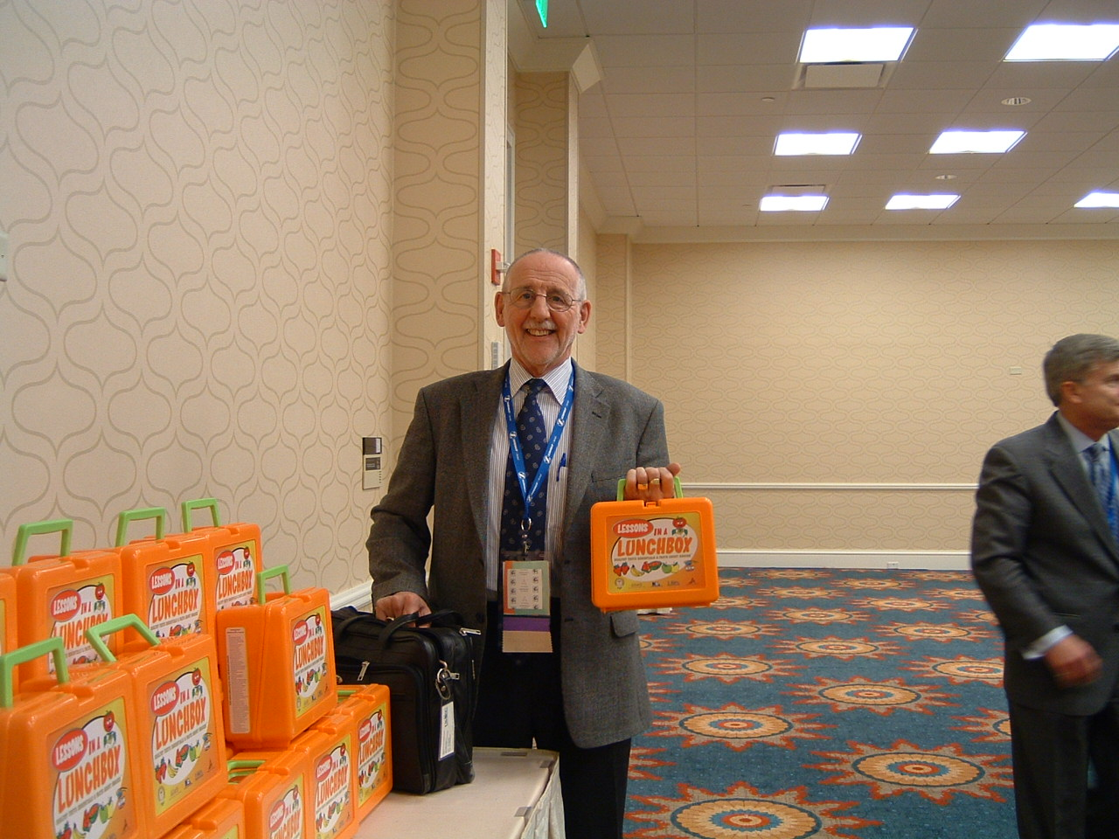
Dr. Mike Reid, Dean, University of Missouri Kansas City
School of Dentistry

Slide 18
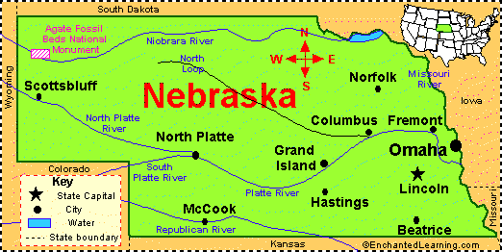
September 2008
9/11/08 Lessons in a Lunch Box Program Introduced Nationally
“The Maryland Children’s Oral Health Institute reported that the
Lessons In A Lunch Box: Healthy Teeth Essentials & Facts About
Snacks™ program had officially gone national when the first
shipment of lunch boxes left Maryland in route to Clinton
Elementary School in Lincoln, Nebraska.”

Slide 19


II. How has the DTA Foundation funding made a difference in the Lessons In A Lunch Box program?

Slide 20

The $25,000 awarded to
The Children’s Oral Health Institute in 2007 by the
1) Paid for the first 5,000 lunch boxes and dental carrot cases.
The acquisition of these finances also contributed the
second and third 5,000 piece orders placed in 2009
and 2011.
2) The grant award encouraged others corporations and
organization to support the Lessons In A Lunch Box
program.
3) It has helped use to improve the lesson plan guide and
transform it into a more comprehensive document.
-more-

Slide 21


















The corporations and organizations that followed with financial
contributions, grant awards, in kind donations and volunteer
support include:

Slide 22
Lesson In A Lunch Box & student dentists
4) The DTA Foundation funding is helping to make a difference in the dental education of student dentists and hygienists via the Lessons In A Lunch Box program, including:
Dental students in ~22 states continue to learned alternative ways to teach oral health prevention, including good dietary behaviors and dental hygiene practices, in both classroom and community settings.
These student doctors of dental medicine continue to be made aware of the tragic oral health circumstances that took the lives of Maryland’s 12 year-old Deamonte Driver and Mississippi’s 6 year-old Alexander Collander.
They witness the excitement of school children because of the attention given to them by these young student dentists- children who live in poverty and attend Title One schools. They see and take part in the nearly uncontrollable jubilance of some of the most economically deprived and most grateful elementary school children in America.
        -more-

Slide 23
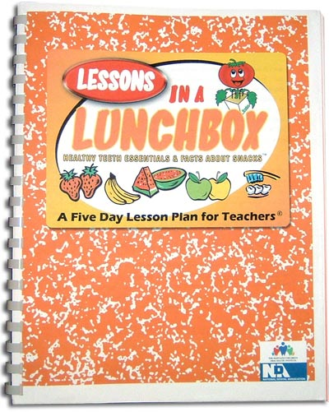
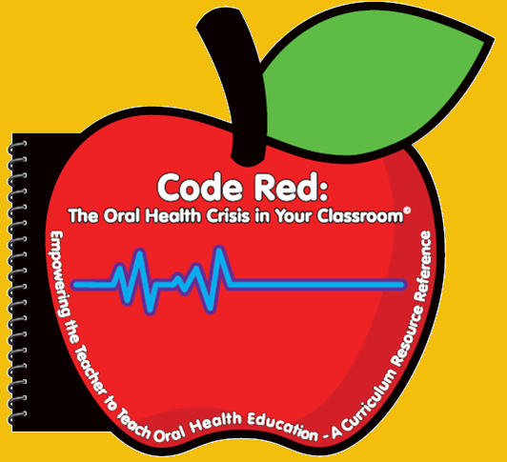

The DTA funding has helped us to improve the lesson plan guide that originally accompanied the Lessons In A Lunch Box program and transform it into a more alluring and more comprehensive document for teachers to support oral health education in the classroom.

Slide 24
DTAF $25,000 and student dentists continued
This first $25,000 continues to help The Children’s Oral Health Institute sensitize student dentists to the unmet oral health care needs of children and adults because of the access to care challenged faced by our profession.
They see and hear firsthand accounts of the pain and suffering children experience from untreated tooth decay during the presentations of the Lessons In A Lunch Box program. On October 1, 2008, Congressman Cummings asked the ~ 300 children in the cafortorum at Cecil Elementary School to raise their hands if they ever had a sick tooth. You could not see the hands that were not raised.
Students are encouraged to be innovative and think outside of the box.
-more-

Slide 25
DTAF $25,000 and student dentists and hygienists, high school and middle school students continued
All dental students must take a six question survey prior to participating in the Lessons In A Lunch Box program. Here they are exposed to the government Medical Assistance Program and learn about the differences in accepting this form insurance versus private pay insurance.
The Children’s Oral Health Institute is able to offer dental and hygiene students, high school and middle school students community service learning opportunities. These young people are able to obtain needed student service learning hours required for graduation.
Dental students and community dentists have opportunities to encourage elementary school children to consider careers in the fields of dentistry, including corporate dentistry during the Lessons In A Lunch Box program presentations.

Slide 26
Some of dental schools that have participated in presenting the Lessons In A Lunch Box program
A.T. Still University of Arizona School of Dentistry & Oral Health
Baylor College of Dentistry
Boston University Goldman School of Dental Medicine
Case Western Reserve University School of Dental Medicine
Creighton University School of Dentistry
Harvard School of Dental Medicine
Howard University College of Dentistry
Meharry Medical College School of Dentistry
University of Connecticut School of Dental Medicine
University of Detroit Mercy School of Dentistry
University of Kentucky College of Dentistry
University of Las Vegas School of Dental Medicine
University of Maryland Baltimore College of Dental Surgery
University of Nebraska Medical Center College of Dentistry
West Virginia University School of Dentistry

Slide 27
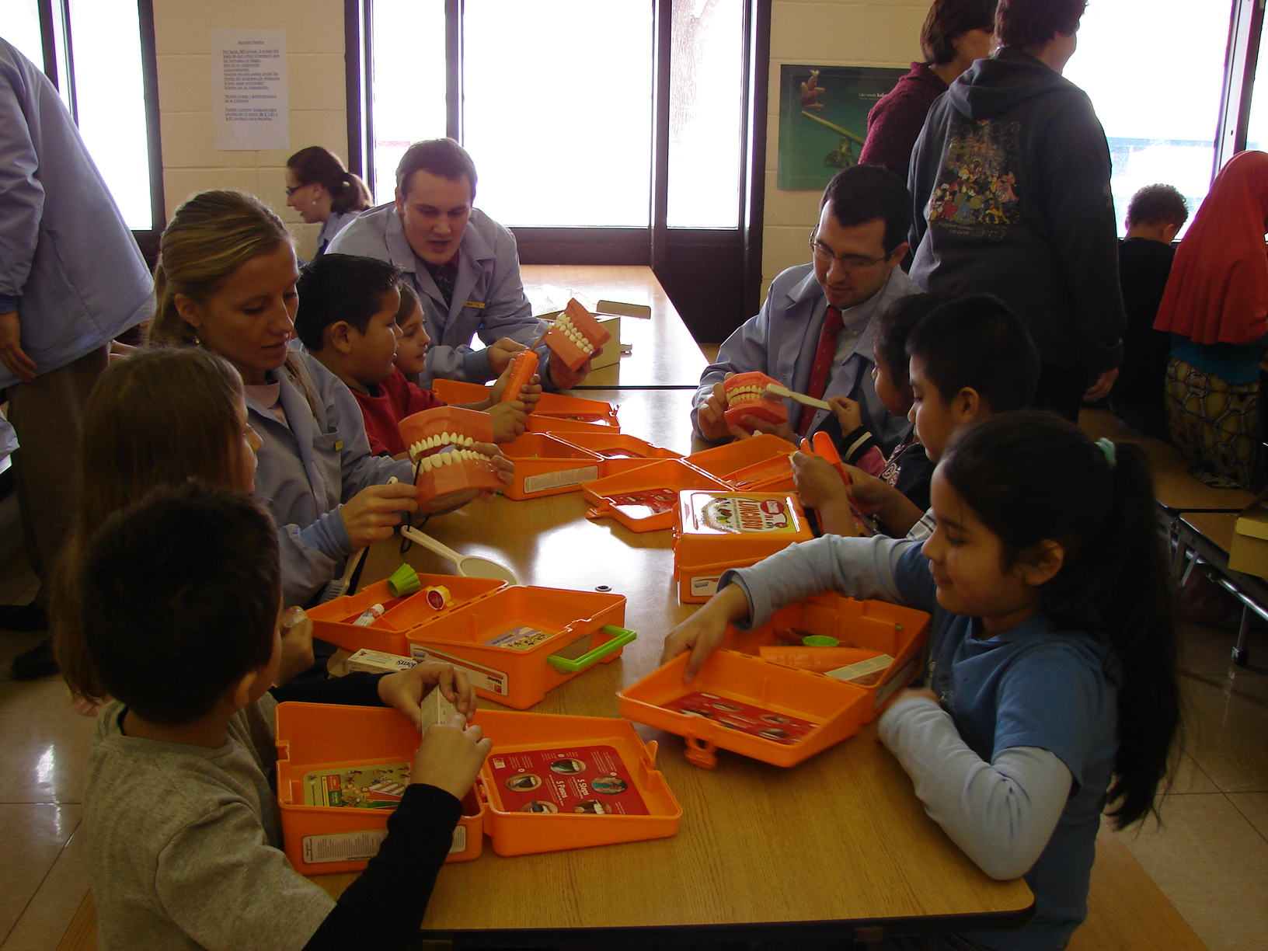
Creighton University dental students help to present the Lessons In A Lunch Box program at an elementary school in Omaha, Nebraska.

Slide 28
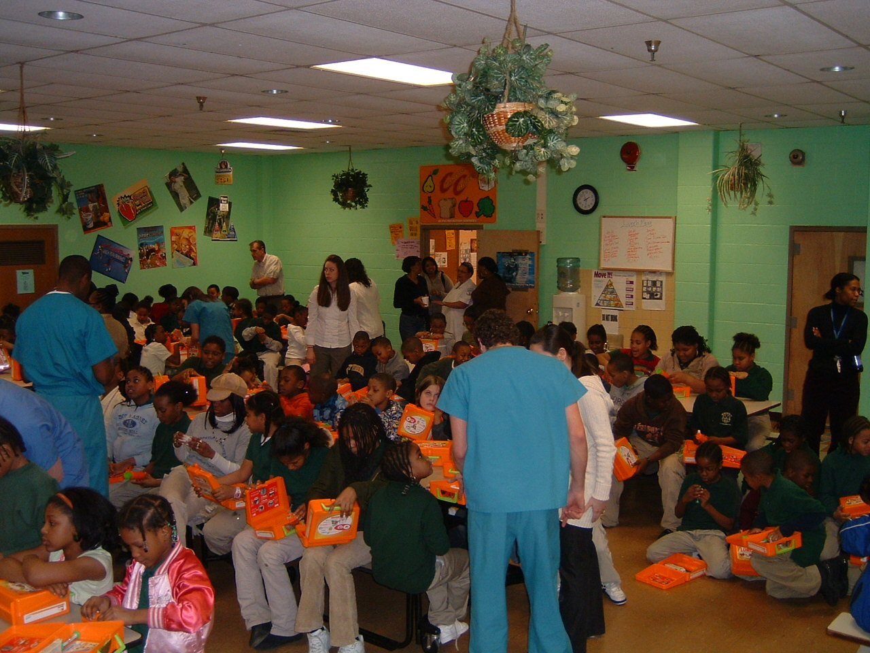
University of Maryland dental students help to present the Lessons
In A Lunch Box program at an elementary school in Baltimore,
Maryland.

Slide 29
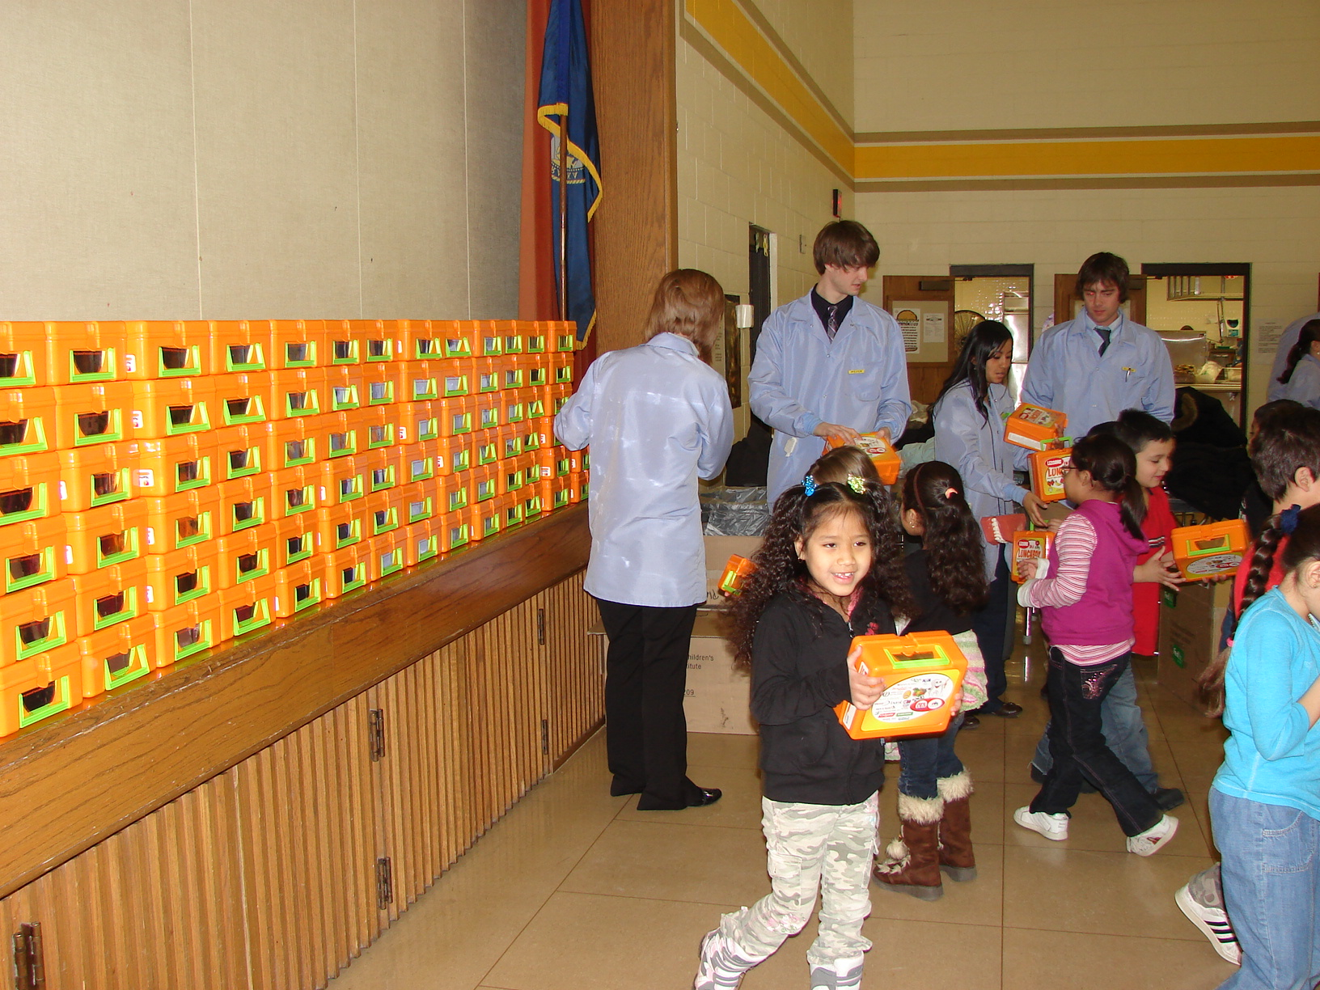
Creighton University dental students distribute lunch boxes at elementary school in Omaha, Nebraska .

Slide 30
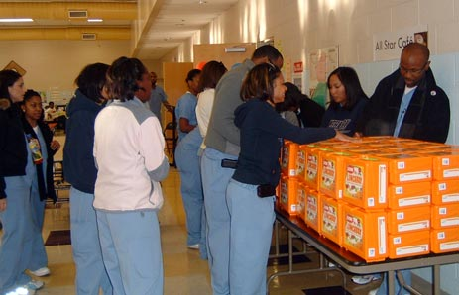
Meharry Medical College dental students prepare to distribute lunch boxes at elementary school in Nashville, Tennessee.

Slide 31
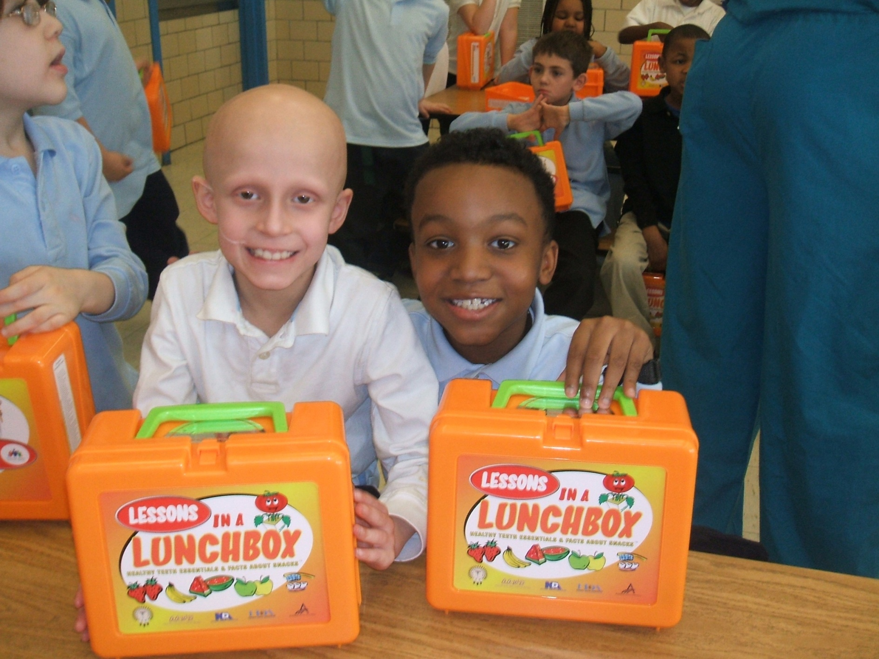
Pals at Jessup pose with lunch box.

Slide 32
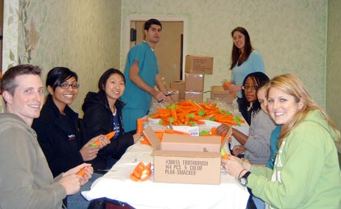
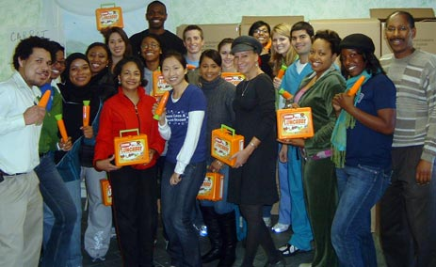
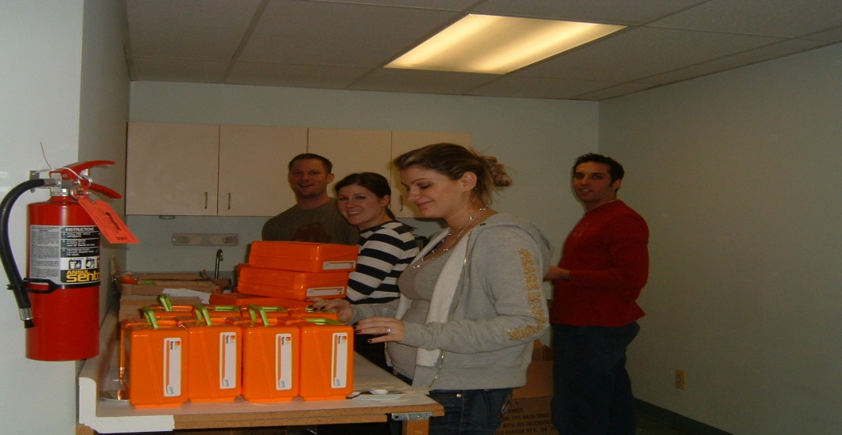
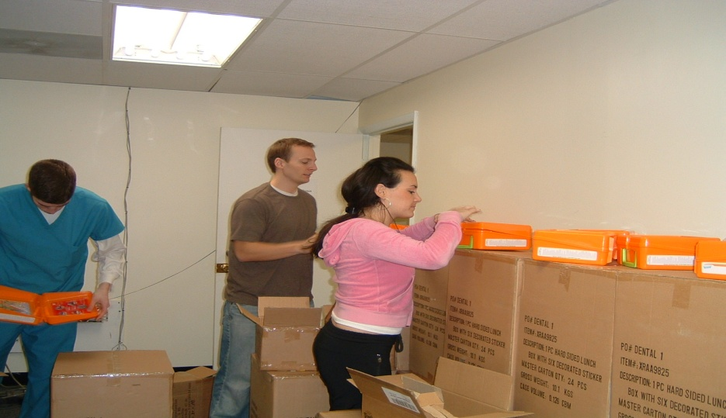
Student dentists from the University of Maryland and Howard University, along with volunteers from area middle and high schools, the Maryland Dental Society, the Maryland State Dental Association, RTF Dental Society, Baltimore City Community College, Baltimore Teacher’s Union, American Association Women Dentists, Delta Dental, DIAKON, SHOFU, Jack & Jill and The Links Incorporated package dental carrot cases and lunch boxes to be shipped around the country for the Lessons In A Lunch Box programs. Students obtain community service credits.

Slide 33
Student doctors are made aware of the tragic oral health circumstances that took the lives of Maryland’s 12 year-old Deamonte Driver, Mississippi’s 6 year-old Alexander Collander and others.

Slide 34
DTAF, $25,000, school administrators, principles, teachers, nurses, parents, local policy makers and national legislators
5) The grant given to The Children’s Oral Health Institute has helped school administrators, principles, teachers, nurses, local policy makers and national legislators understand the eminence value of the comprehensive learning opportunities offered through oral health education. These opportunities are outline in via Lessons In A Lunch Box and the Code Red curriculum resource reference. They include the incorporation of oral health education in mathematics, reading, spelling, science, history, health and nutrition lessons.
Many of these leaders have witnessed and gained a better appreciation and respect for the impact poor oral health has on learning and behaviors in the classroom, at home and in society. Some acknowledge their appreciation of the Lessons In Lunch Box program from personal experiences. These passionate personal stories are often revealed during the presentations. As a result these leaders have gone on to support advocacy for the inclusion of oral health education in public school curriculum.

Slide 35
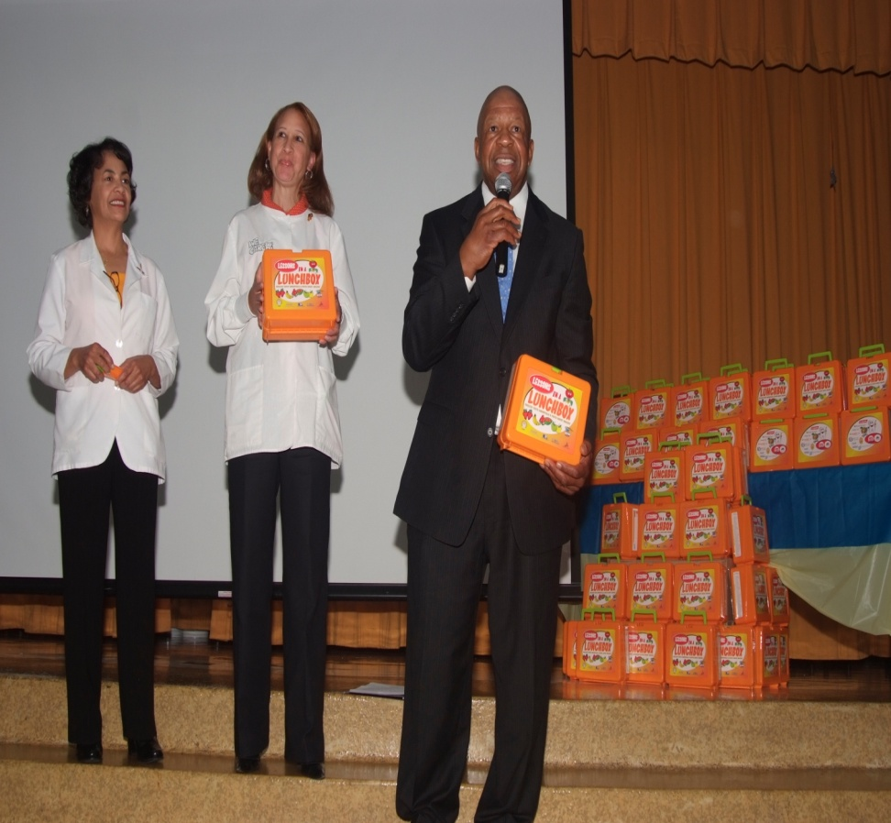
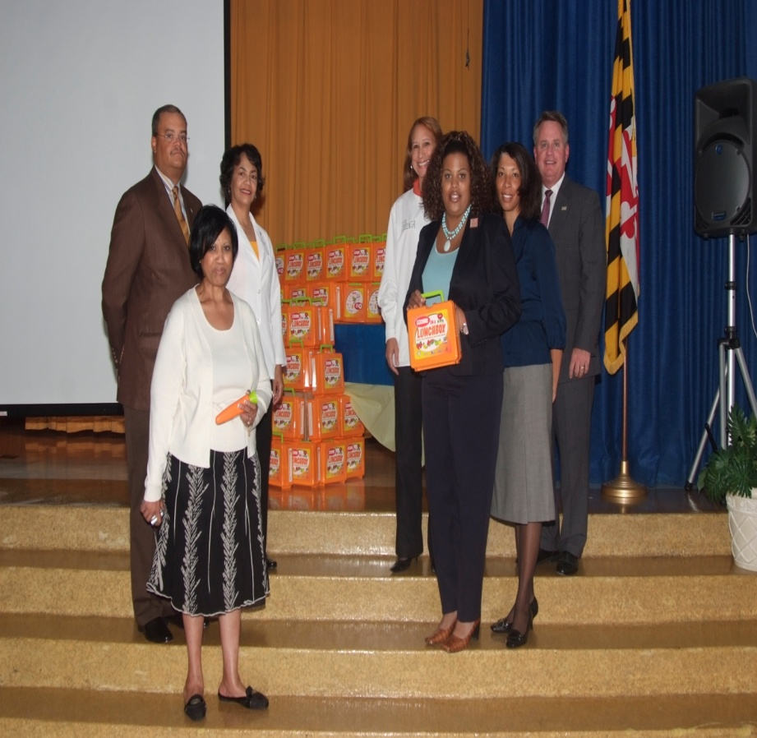
9/30/08 Students Receive Captivating Lunch Boxes at Blue Ribbon Celebration (Cecil Elementary)
Lessons In A Lunch Box kicked off by Maryland congressman Elijah Cummings in Baltimore.
Baltimore Mayor Stephanie Rollins Blake and members of the MDS and MSDA on hand for the oral health education presentation.

Slide 36
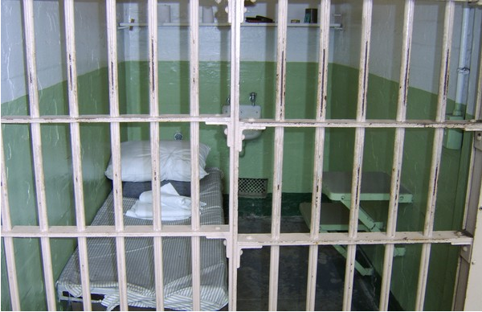
DTAF and $25,000 help to provide temporary employment for a formally incarcerated mother and son.
6) In addition to offering dental and dental hygiene students, high and middle school students, and civic organizations and individuals volunteer opportunities, the $25,000 DTAF seed money provided The Children’s Oral Health Institute a chance to offered a mother and son recently released from prison approximately 5 weeks of temporary employment. The pair packaged the dental carrot cases that are included in the lunch boxes with the toothpaste, toothbrush and dental floss.

Slide 37
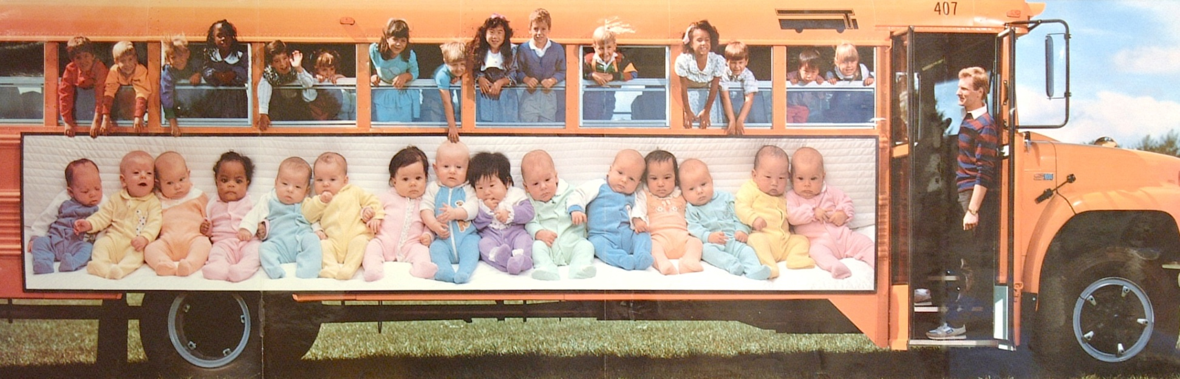
10/1/08 Maryland Dentists Recommend Oral Health Curriculum
7) The Lesson In A Lunch Box program was included in the discussions with the Maryland State Department of Education. The funding from the DTAF help to support the conversation to incorporate oral health into the public school curriculum.

Slide 38
2009 and 2010
The DTAF grant helped The Children’s Oral Health Institute acquire another 5,000 lunch boxes in 2009.
The grant helped the Lessons In A Lunch Box program
reach 10,000 elementary school children in 2010.
8/3/10 Oral Health Initiative Continues Expansion Reaching 10,000 Children Nationally
.

Slide 39
2011
10) The DTAF grant helped The Children’s Oral Health Institute
acquire another 5,000 lunch boxes in 2011.
11) The Lessons In A Lunch Box program and the Code Red: The
Oral Health Crisis in Your Classroom initiative received
acceptance into the U.S. Office of Minority Health-led (OMH)
National Partnership for Action (NPA) to End Disparities in 2011.
12) By 2011 knowledge of The Children’s Oral Health Institute
reached beyond US Shores. The DTAF grant helped to give
this international visibility to the Lessons In A Lunch Box
program. The Maryland Children’s Oral Health changed
their name by dropping Maryland.

Slide 40
2012
  13) We feel the Lessons In A Lunch Box program helped to
fuel the oral health education movement in Maryland. Oral Health Education- Certification and Monitoring
bill on May 22, 2012.
5/22/12 Oral Health Advocates March Into May Jubilant
14) The Lessons In A Lunch Box program has reached
22 states and 15,000 school children because of the
initial funding provided in 2007.
15) The Children’s Oral Health Institute met MSDE superintendent,
Dr. Lillian M. Lowery to discuss advancing oral health
education in Maryland public schools. The presentation
included the Lessons In A Lunch Box program materials.
The original funding from the DTAF grant help to make this opportunity possible.
11/4/12 Positive Reception for Oral Health Education Paradigm

Slide 41
DTAF, $25,000 and organized dentistry in Maryland
16) The exposure from the support the DTAF afforded the Lessons In A Lunch Box program helped to solidify a renewed coalescence of organized dentistry in the state of Maryland. This coalescence between the Maryland Dental Society (MDS),the Maryland State Dental Association (MSDA), the Maryland Academy of General Dentistry (MAGD), the Maryland Dental Hygiene Association (MDHA) and The Children’s Oral Health Institute (COHI) has helped to keep attention on the need identify innovative ways to improved access to oral health care and relieve the ongoing pain and suffering children experience while trying to learn at school. The initial financial resource offered from the DTAF has helped to led to :
  The March 2013 National Governors Association Case Study, Maryland Passes Oral Health Education Legislation Through Collaborative Approach http://statepolicyoptions.nga.org/casestudy/maryland-passes-oral-health-education-legislation-through-collaborative-approach
  The Pathway to Help Get Oral Health Education Legislation Passed in Your State by the COHI, MDS, MSDA, MAGD and MDHA. This template may prove beneficial to others. Visit the COHI website at www.mycohi.org to download this document.

Slide 42

2013

Slide 43
III. Current status of the Lessons In A Lunch Box program
January 2013 The Children’s Oral Health Institute presents the Lessons In A
Lunch Box program, the Code Red: The Oral Health Crisis in Your Classroom initiative and other oral health teaching opportunities to Maryland’s 24 district superintendents.
February 2013 The Children’s Oral Health Institute receives $10,000 grant award for the Lessons In A Lunch Box program from Delta Dental.
March 2013 The NGA releases a Case Study referencing the Lessons In A Lunch Box program and Code Red: The Oral Health Crisis in Your Classroom initiative.
April 2013 The Children’s Oral Health Institute continues to seek grant funding and financial resources to further expand the outreach of the Lessons In A Lunch Box program.

Slide 44

IV.
The future of the Lessons In A Lunch Box program is dependent upon our continued ability to obtain financial support. We look forward to continuing to expand this program nationally. Ultimately The Children’s Oral Health Institute would like to identify nonprofit organization in other states that focus on oral health education and empower them with the information and resources necessary to execute Lessons In A Lunch Box independently.

Slide 45

THANK YOU !

